Slide 1
New Release 2023
THE EARLY SPECIALIST
A high yielding well adapted AH “Quick Winter” wheat for WA available for 2023 planting
Alternative to:
ILLABO
LONGSWORD
NIGHTHAWK

Slide 2
Overview
LongReach Mowhawk (LPB19-14343) WA bred and selected, is a NEW Quick Winter variety with similar growth habit and maturity to Longsword
Mowhawk has an AH final classification (received March 2023) in the Western zone.
Mowhawk has broad general adaption and is ideally suited to higher production areas and early-break scenarios.
Mowhawk is 3-5 days quicker to heading and 10-15% higher yielding than the current benchmark winter variety, Illabo.
It has a sowing window from late March through to late April (optimal sowing date, before Anzac day), the the Medium-High rainfall areas of WA.
Mowhawk has an excellent all-round disease package
Mowhawk ia a potential dual-purpose wheat, showing a useful grazing habit and good yield recovery in initial studies.
Attribute | Rating
Stem Rust (Sr) | RMRp
Leaf Rust (Lr) | MRp
Stripe Rust (Yr) | RMRp^{WA}
Yellow Spot (Yls) | MRMSp
Powdery Mildew (Pm) | RMRp^{WA}
Pre-harvest Sprouting (FNI) | 5p
Boron | MT
Aluminium | MT
Acidity | MT-MI
EPR rate | $4.00 (GST exc.)
Farmer to Farmer Trade | Allowed
Classification | AH
Preliminary ratings based on 2022 NVT ratings and *Powdery Mildew rating from LongReach disease pathologist screens, 13th Feb 2023.

Slide 3
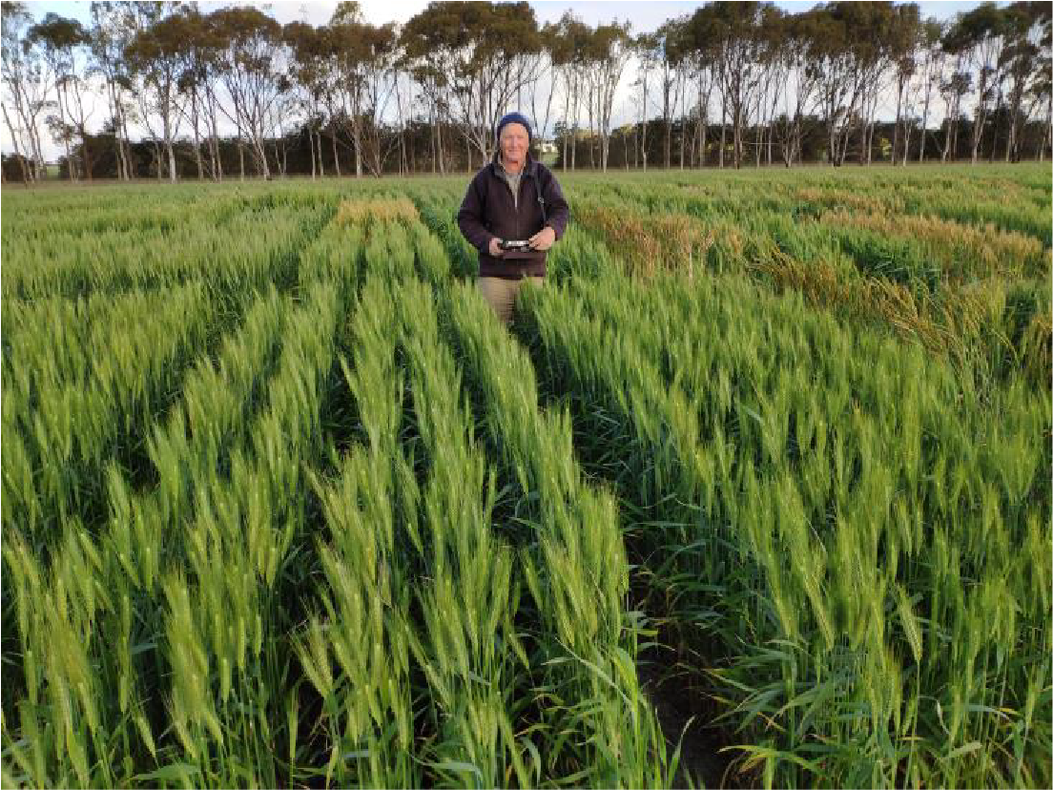
Variety Background
Mowhawk (Scepter/GX1438(DM02-25-SB02-167/2*Mace) was developed after significant investment into a dedicated pre-breeding project established by LongReach Plant Breeders with GXE Crop Research for targeted trait enrichment in widely adapted backgrounds.
Mowhawk is well suited to WA environments with good abiotic stress tolerance to both Boron and Acid/Aluminium toxicity from the broadly adapted parental material used in the complex cross.
Mowhawk tested as LPB19-14343, was first entered into LongReach yield trials in 2019 and WA early NVT trials in 2022.
Mowhawk was chosen as a playful yet fitting name for its potential to also be grazed early on in the season.
LongReach “Innovative Trait Project”
Kevin Young from GXE Crop Research standing in front of plot of Mowhawk at a Scaddan trial (photo by Robin Willson).

Slide 4
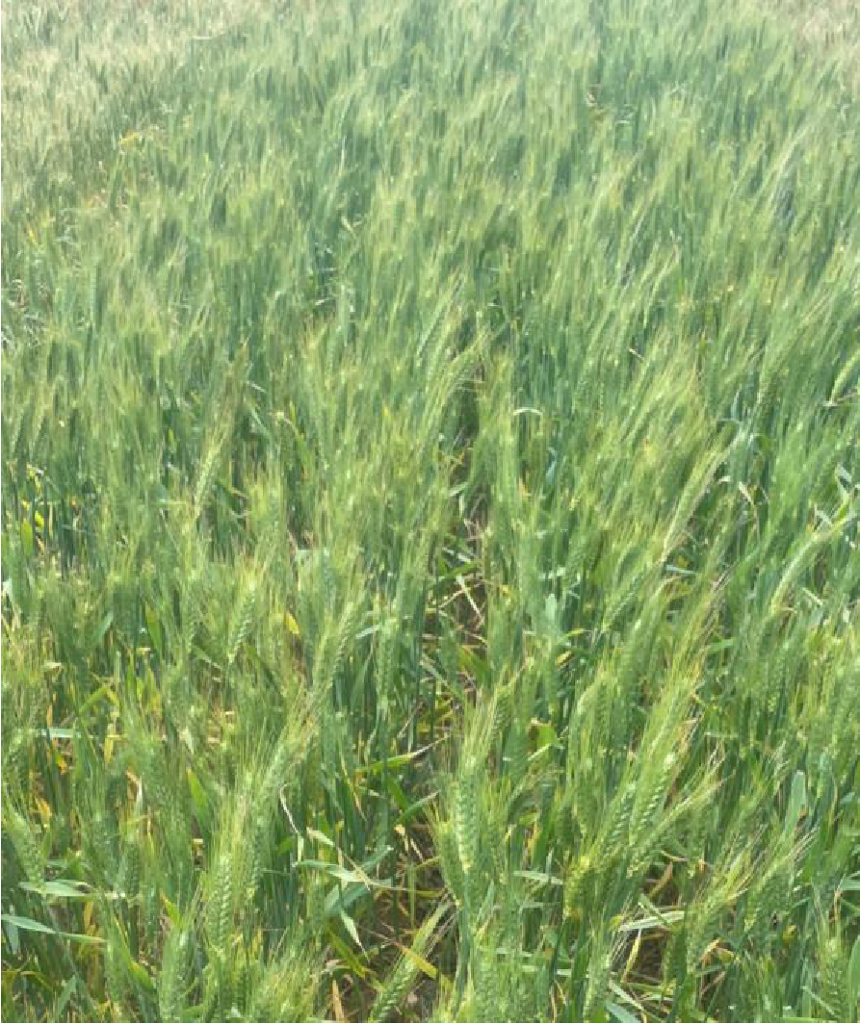
Agronomic Features
Medium coleoptile length and medium-tall plant height
Very good tillering, acceptable early vigor and very good biomass variety
Fully awned with lots of medium size heads with medium sized grain
Very good all-round abiotic stress tolerance variety
Shown good diverse soil tolerances
Acceptable grain receivals package
2022 LongReach internal replicated lab assay data for Boron, Acid, Aluminium and Alkaline tolerance presented as extrapolated ratings for Mowhawk and three relevant controls
Abotic Stress Rating | Denison | Illabo | Mowhawk | Rockstar
Boron Tolerance Bo-RRL (%) | MT | MI | MT | MI
Acid pH 4.2 RRL (%) | T | T | T | T
Aluminium Tolerance pH 4.2 Al-RRL (%) | MT | MI | MT | MI
Alkaline Tolerance pH 9.5 RRL (%) | MT | MI | MT | MT
*LRPB interpretations of internal data - For Boron, Acid and Al, MI = Moderately intolerant 25-50%; MT= Moderately tolerant 50-75% T= Tolerant >75%; For Alakline- MI = Moderately intolerant 11-15%; MT = Moderatley Tolerance >15%
Mowhawk, with the characteristic lots of medium heads, in a plot at the 2022 early NVT Hyden.

Slide 5
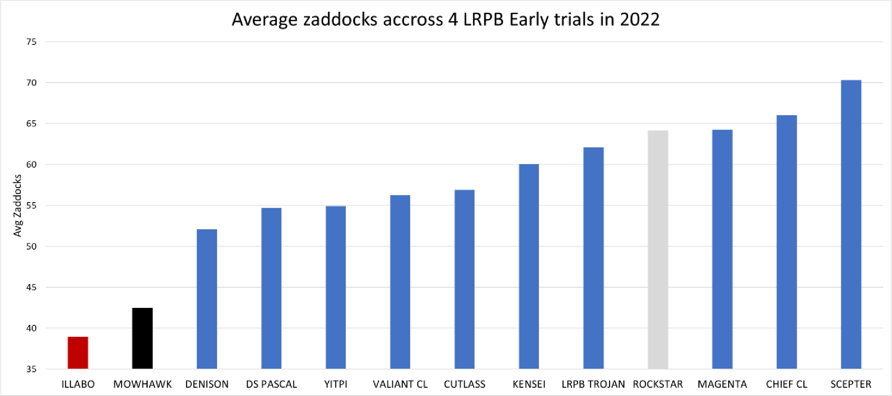
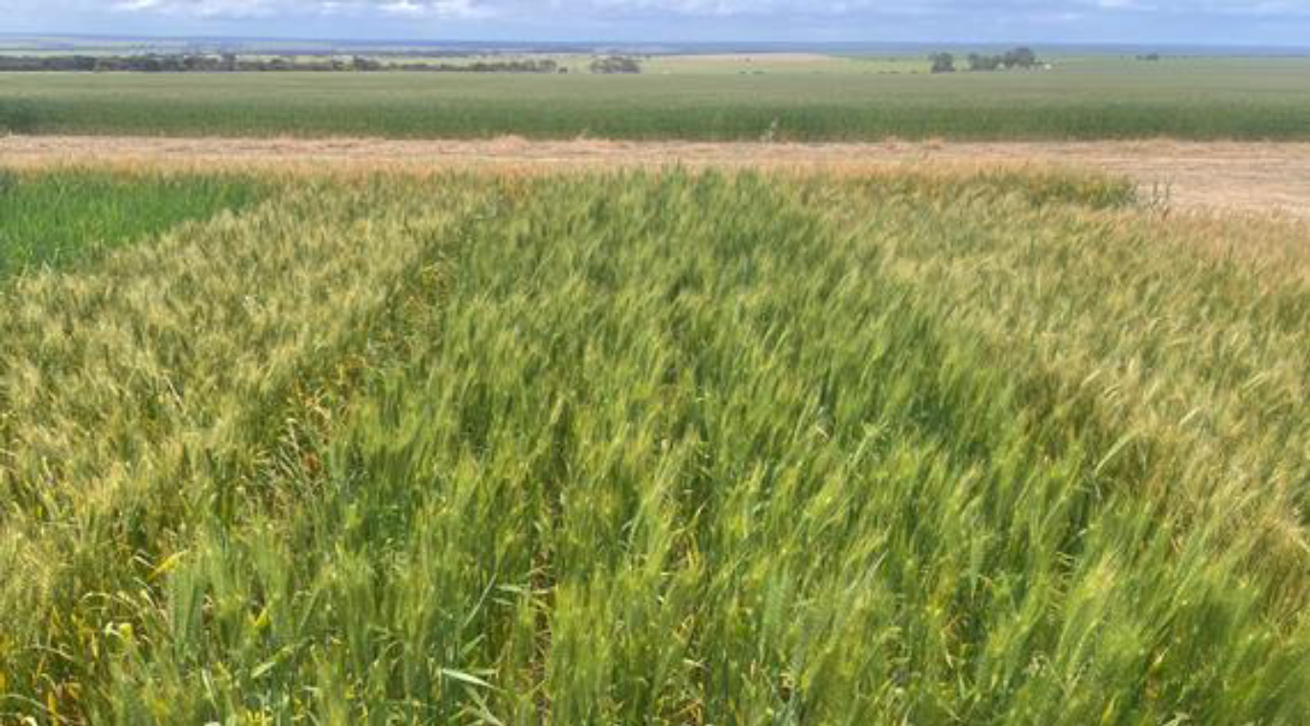
Maturity Fit
Mowhawk is a unique “Quick Winter” type that fits between Illabo and Longsword
Has shown to be well suited to warmer WA environments
Tends to move closer to Longsword maturity further South, and slower towards Illabo maturity in the more Northern areas
Kinsei
Mowhawk
Magenta
March |  | April |  |  |  | May
Week 3 | Week 4 | Week 1 | Week 2 | Week 3 | Week 4 | Week 1
Early NVT trial, Hyden 2022, Kinseip (Left), Mowhawkp (Middle), Magentap (right), showing the maturity difference of a “Quick Winter” against other Mid-slow springs
Recommended sowing window for Mowhawk is late March through to end of April (Optimal sowing date, before Anzac Day), Grey shading – not recommended; Blue shading - recommended

Slide 6
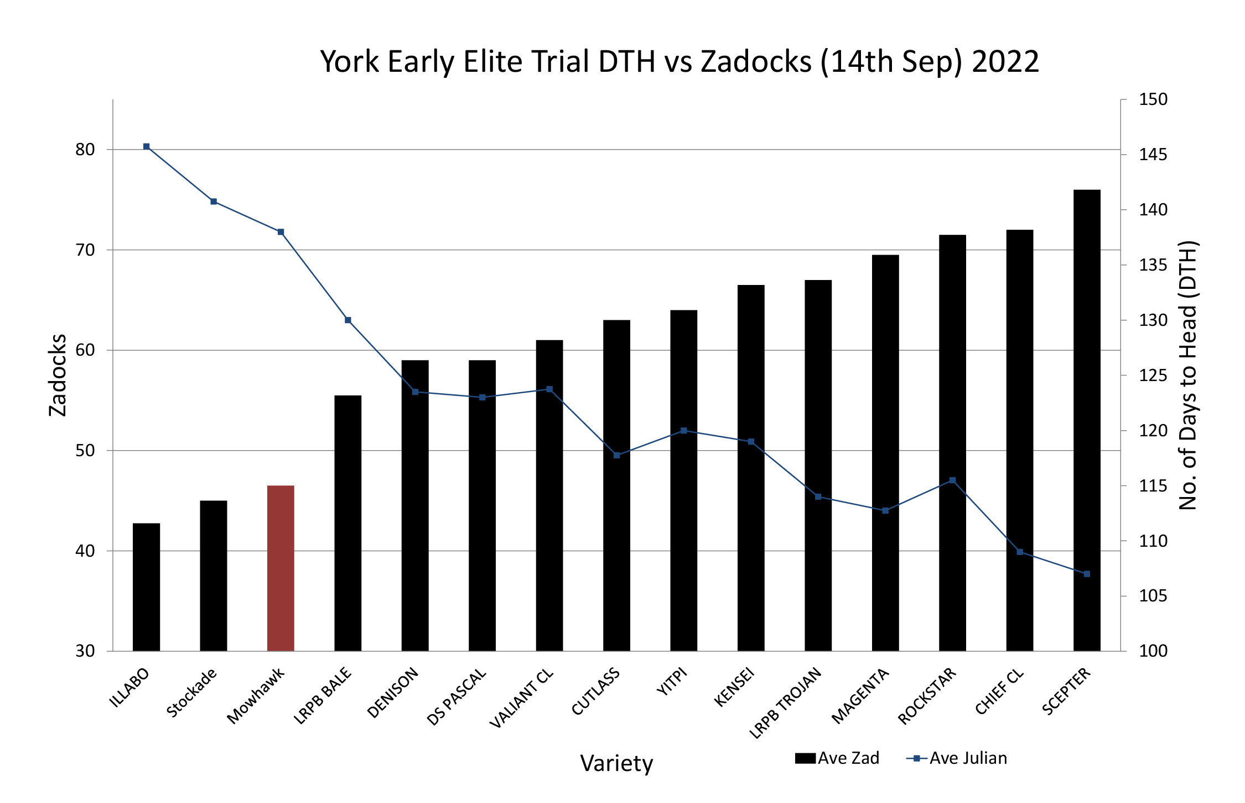
Maturity Fit – Days to heading
Time Sown | Scepter | Denison | Illabo | Mowhawk | RockStar
April Sowing | 101 | 113 | 153 | 150 | 107
May Sowing | 110 | 122 | 137 | 134 | 117
Days after Scepter | 0 | 7-20 | 15-50 | 12-50 | 5-12
* DIRPD WA 2022 TOS data averaged heading data from four sites across different TOS in April and May
Mowhawk averages 3-5 days quicker to head and flowering than Illabo

Slide 7
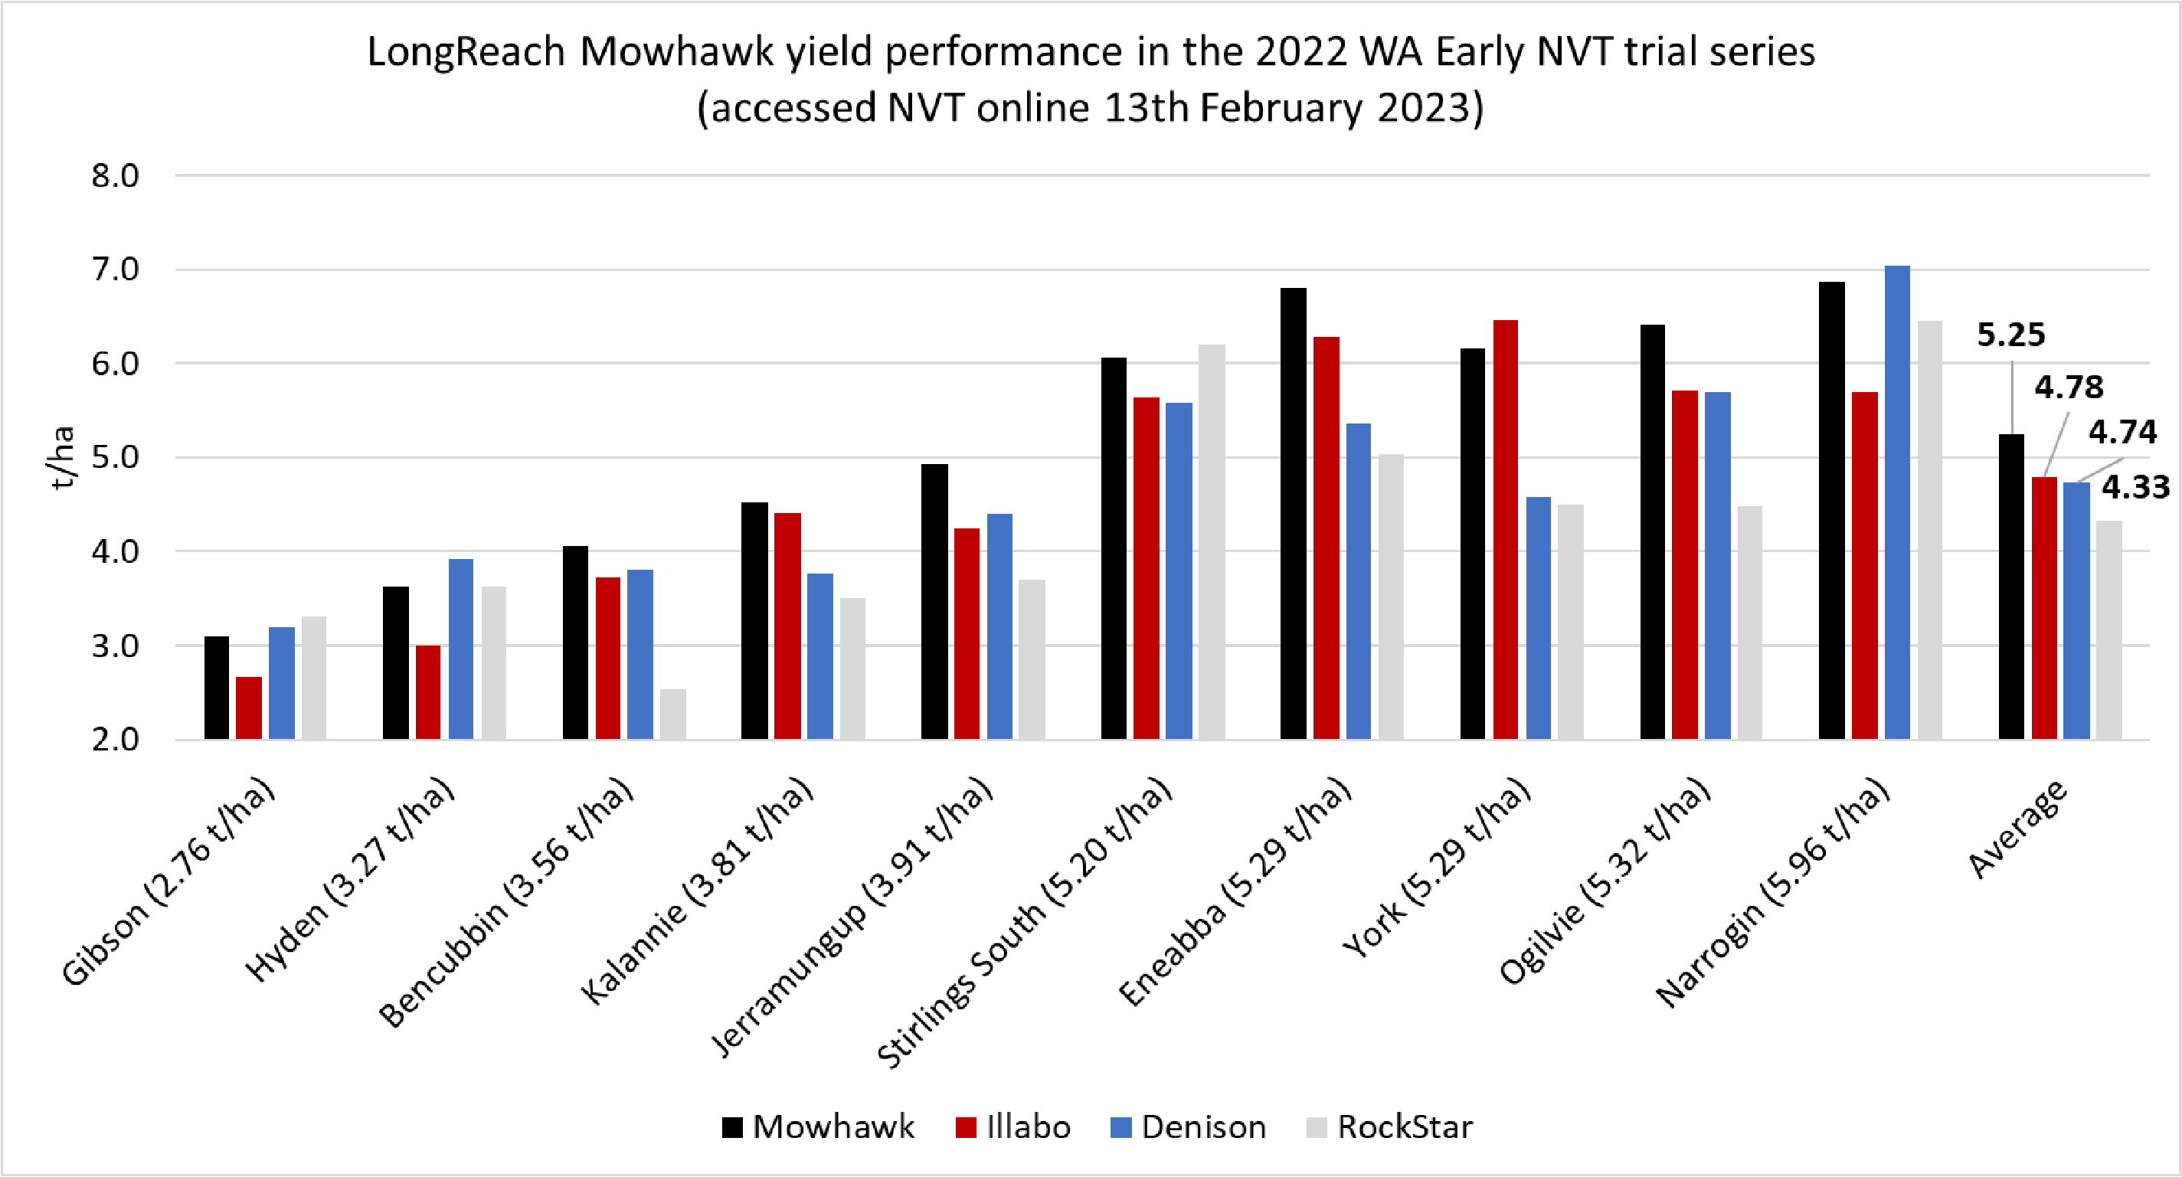
2022 NVT individual site yield performance
2022 WA Early NVT trial series yield t/ha performance (10 sites)

Slide 8
2022 NVT individual site yield performance
2022 WA Early NVT trial series yield performance shown as relative SMY (10 sites)
Variety | AVG SMY | Ogilvie | Eneabba | Narrogin | York | Bencubbin | Kalannie | Huden | Jerramungup | Gibson | Stirlings Sth
Mowhawk | 119 | 124 | 136 | 113 | 121 | 127 | 124 | 103 | 117 | 103 | 111
Longsword | 112 | 127 | 129 | 101 | 119 | 124 | 113 | 88 | 105 | 106 | 104
Illabo | 110 | 105 | 122 | 103 | 123 | 115 | 125 | 100 | 111 | 94 | 103
Valiant CL Plus | 108 | 107 | 114 | 101 | 92 | 113 | 99 | 107 | 128 | 113 | 112
Cutlass | 107 | 117 | 99 | 114 | 102 | 122 | 108 | 115 | 93 | 101 | 102
Denison | 106 | 111 | 100 | 114 | 81 | 118 | 96 | 104 | 119 | 125 | 102
Kinsei | 101 | 97 | 99 | 102 | 96 | 81 | 113 | 105 | 107 | 104 | 107
Rockstar | 98 | 84 | 97 | 103 | 116 | 83 | 87 | 108 | 73 | 120 | 110
Yitpi | 93 | 101 | 84 | 97 | 92 | 95 | 90 | 98 | 104 | 102 | 76
Magenta | 88 | 83 | 76 | 92 | 96 | 100 | 108 | 97 | 73 | 90 | 74
Site Mean (t/ha) | 4.46 | 5.20 | 5.36 | 6.14 | 5.31 | 3.21 | 3.68 | 3.37 | 4.04 | 2.85 | 5.20

Slide 9
NVT long term MET yield performance
2022 WA Early NVT MET Long Term Yield Report Friday Feb 24 2023 | Denison | Illabo | Mowhawk | Rockstar
 | Group | 1.5 | 2 | 2.5 | 3 | 3.5 | 4 | 4.5 | 5 | 5.5 | 6
 | Mean Yield | 1.19 t/ha | 21.87 t/ha | 2.20 t/ha | 2.81 t/ha | 3.18 t/ha | 3.71 t/ha | 4.14 t/ha | 4.62 t/ha | 5.21 t/ha | 5.96 t/ha
Variety | Trials | 1 | 1 | 4 | 3 | 4 | 4 | 4 | 4 | 6 | 1
Mowhawk | 10 | 102! | 106! | 103! | 104 | 114 | 117 | 111 | 105 | 119 | 115
RockStar | 28 | 105! | 119 | 124 | 118 | 116 | 91 | 113 | 122 | 104 | 108
Denison | 22 | 115 | 107! | 113 | 116 | 115 | 106 | 112 | 110 | 104 | 118
Illabo | 32 | 89 | 100 | 92 | 91 | 98 | 108 | 99 | 96 | 111 | 96
DS Pascal | 23 | 93 | 103 | 103 | 99 | 94 | 88 | 96 | 103 | 94 | 88
!-This variety was not present in trials in this yield range and is predicted yield only
Mowhawk maintains a 10-15% yield advantage over Illabo across years and wide yield range
Mowhawk tends to have higher yield advantage over Illabo in sub 4.0 t/ha average production areas

Slide 10
DIRPD WA TOS yield performance 2021
*TOS Yield summary data supplied by the Department Primary and Regional Development Government of Western Australia
Mowhawk showing consistent yield advantage over Illabo across most 2021 TOS and sites
Average yields >0.25-0.75 t/ha better than Illabo
Mowhawk shows reliable and stable yields across TOS when compared to Illabo

Slide 11
DIRPD WA TOS yield performance 2022
*TOS Yield summary data supplied by the Department Primary and Regional Development Government of Western Australia
Mowhawk showing consistently higher yield than Illabo across most TOS and sites in 2022
Average yield >0.5 t/ha better than Illabo
Mowhawk showing stable yield advantage across TOS, sites and years (2021-2022) compared to Illabo

Slide 12
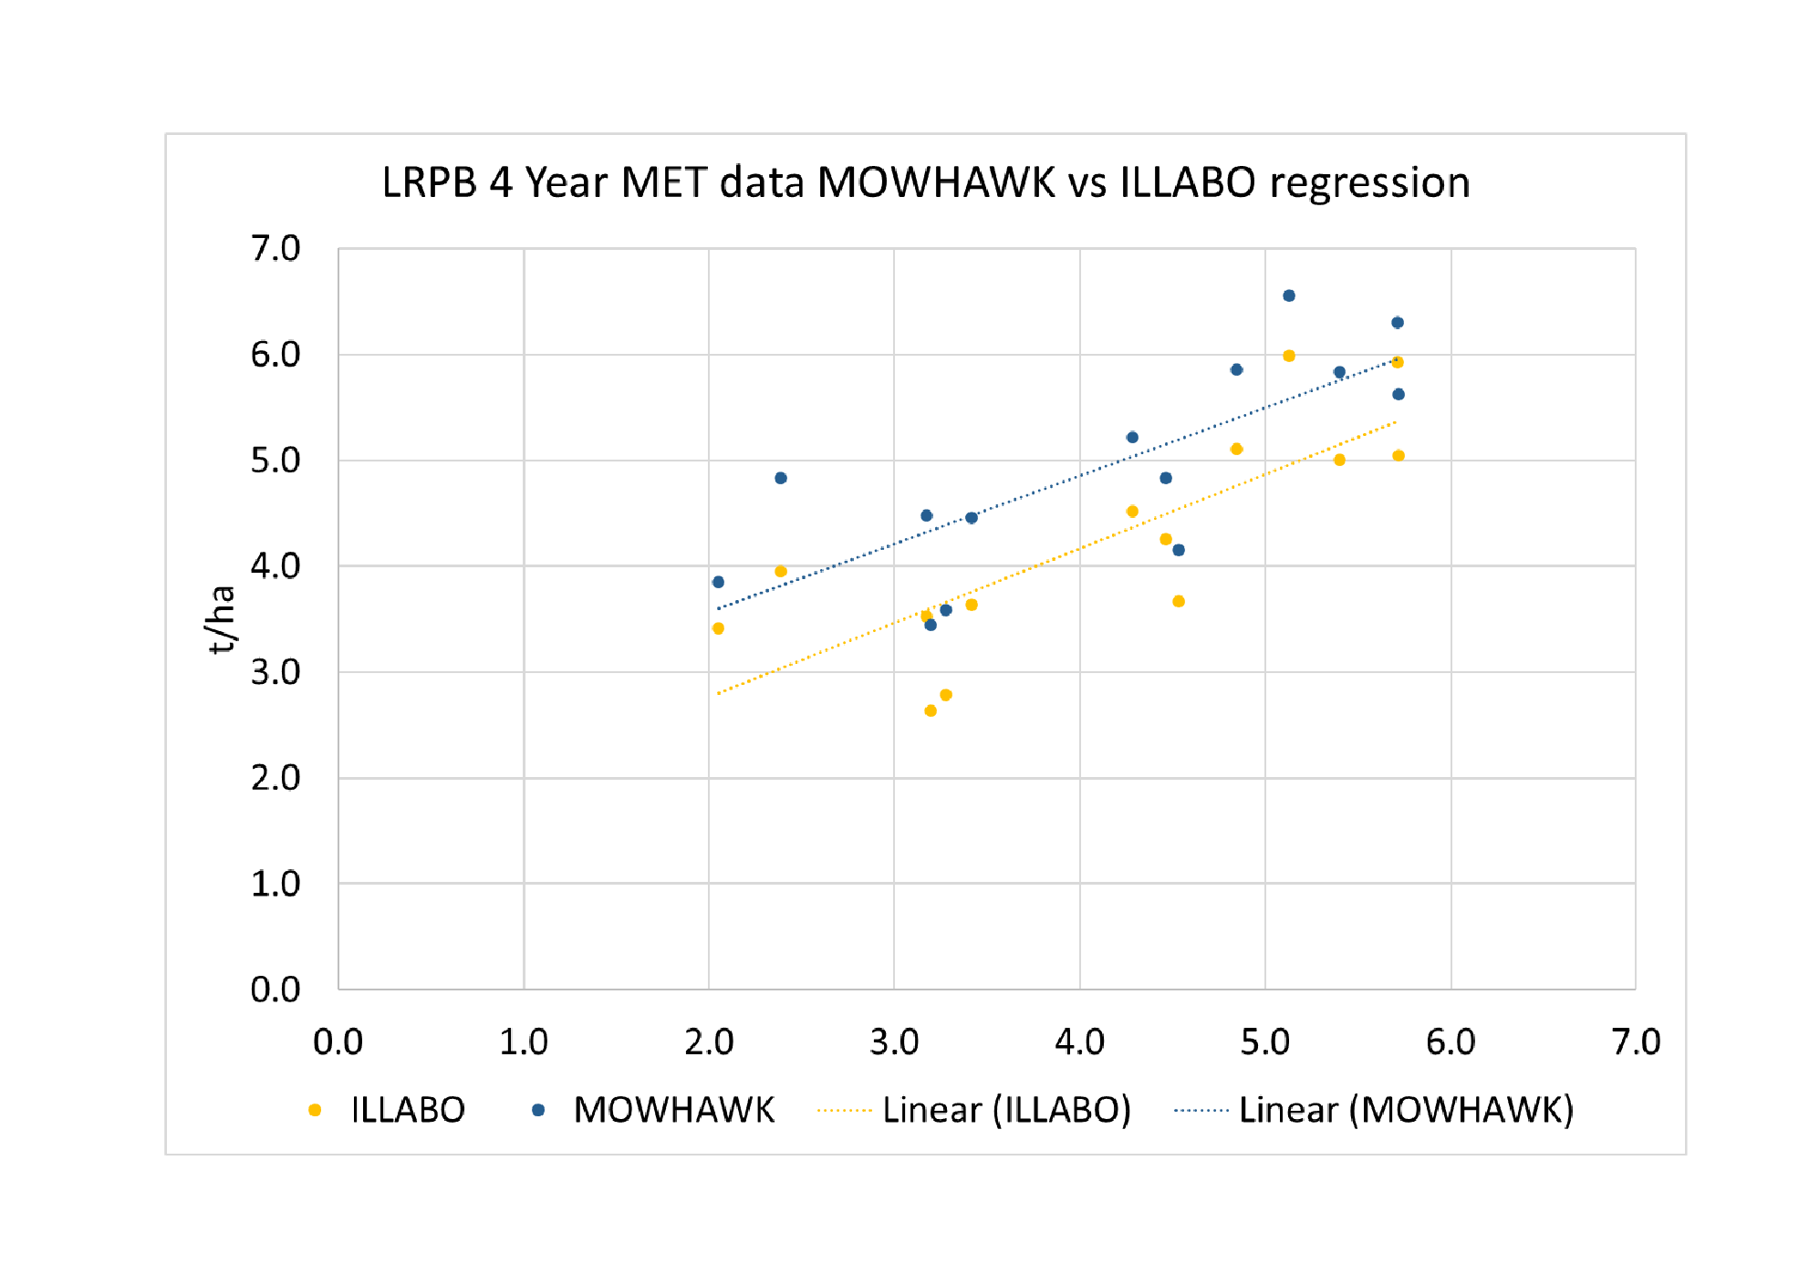
LRPB long term MET yield performance (2019-2022)
Mowhawk maintains a stable 10-15% yield advantage over Illabo across years and environments
Mohawk's advantage over Illabo is higher in sub 4.0-4.5 t/ha average production areas
Mowhawk out yields Illabo on average by 0.5 t/ha more
Tends to finish off better in tighter and harder finishing areas
 | MET |  |  |  |  | 2022 Sites
LINCD | t/ha | Avg | C1 6.01 t/ha | C2 4.72 t/ha | C3 4.37 t/ha | t/ha | Avg | Bencubbin | Esperance | Kojunup | York
RockStar | 5.19 | 109 | 109 | 94 | 116 | 4.74 | 99 | 71 | 92 | 109 | 119
Denison | 5.01 | 105 | 100 | 105 | 107 | 5.03 | 105 | 105 | 105 | 102 | 110
Kensei | 4.97 | 104 | 103 | 100 | 107 | 4.82 | 101 | 75 | 98 | 110 | 116
Cultass | 4.92 | 103 | 95 | 106 | 105 | 5.00 | 105 | 106 | 103 | 97 | 116
Mowhawk | 4.88 | 102 | 105 | 99 | 103 | 4.73 | 99 | 91 | 109 | 102 | 92
Valiant CL Plus | 4.77 | 100 | 98 | 103 | 99 | 4.88 | 102 | 108 | 98 | 99 | 105
LRPB Trojan | 4.69 | 98 | 101 | 89 | 102 | 4.43 | 93 | 66 | 100 | 99 | 102
Scepter | 4.58 | 96 | 98 | 80 | 103 | 4.05 | 85 | 65 | 66 | 97 | 105
DS Pascal | 4.56 | 96 | 103 | 95 | 93 | 4.64 | 97 | 107 | 100 | 101 | 80
Yitpi | 4.45 | 93 | 93 | 96 | 93 | 4.56 | 95 | 90 | 106 | 89 | 98
Magenta | 4.29 | 90 | 90 | 90 | 90 | 4.20 | 88 | 82 | 75 | 94 | 97
Illabo | 4.23 | 89 | 97 | 85 | 86 | 4.19 | 88 | 83 | 88 | 95 | 82

Slide 13
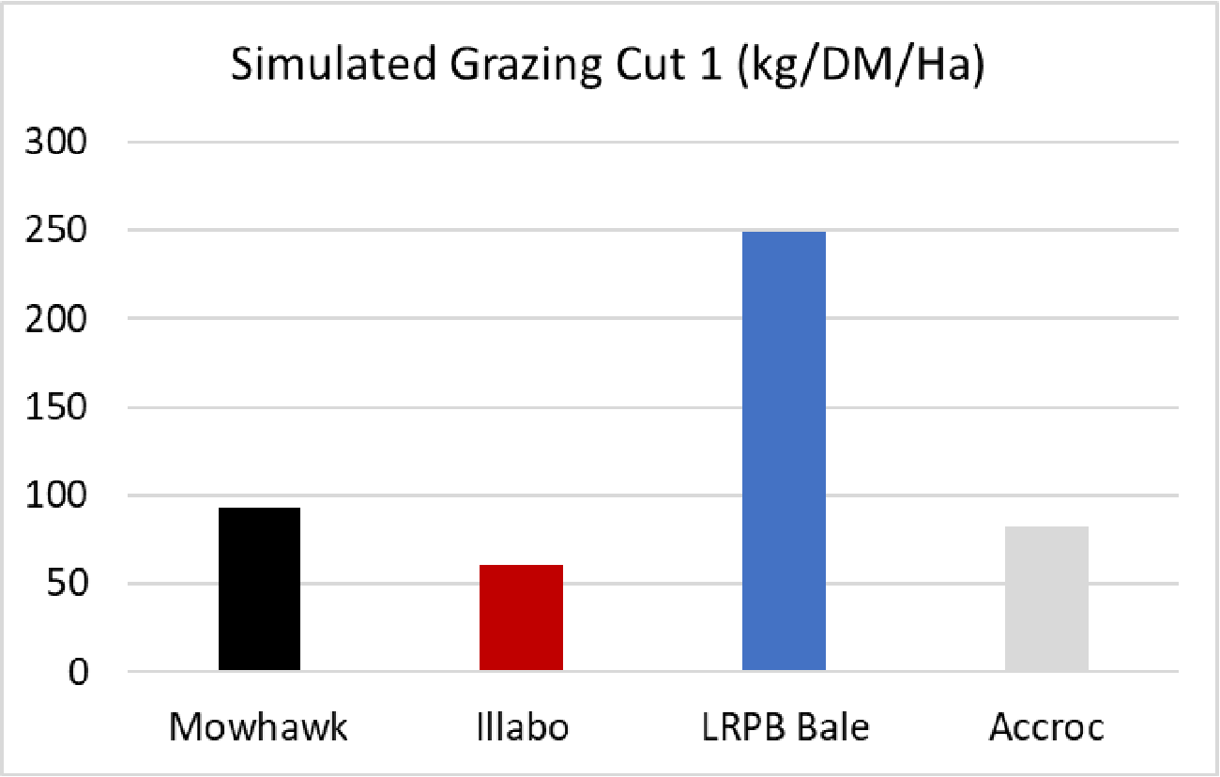
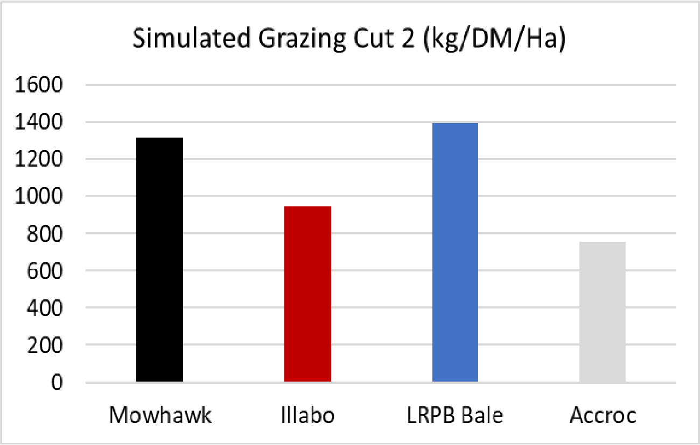
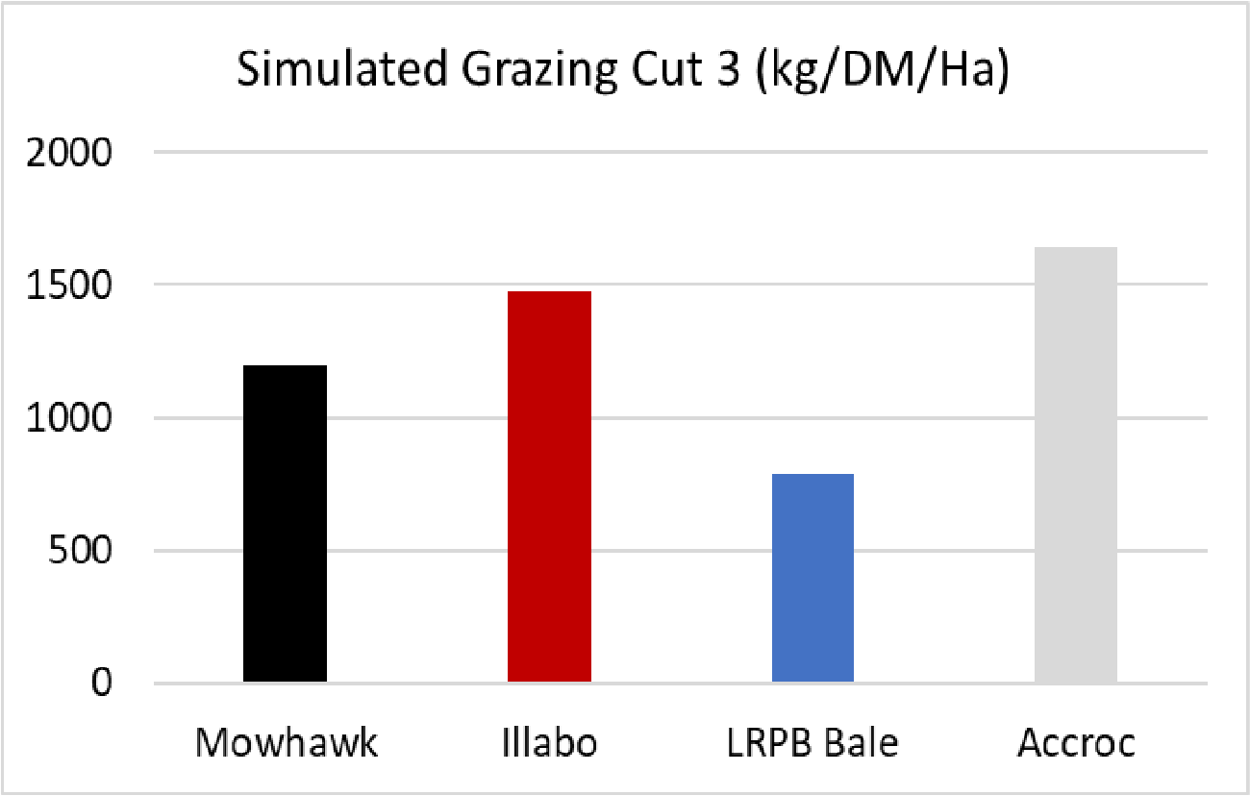
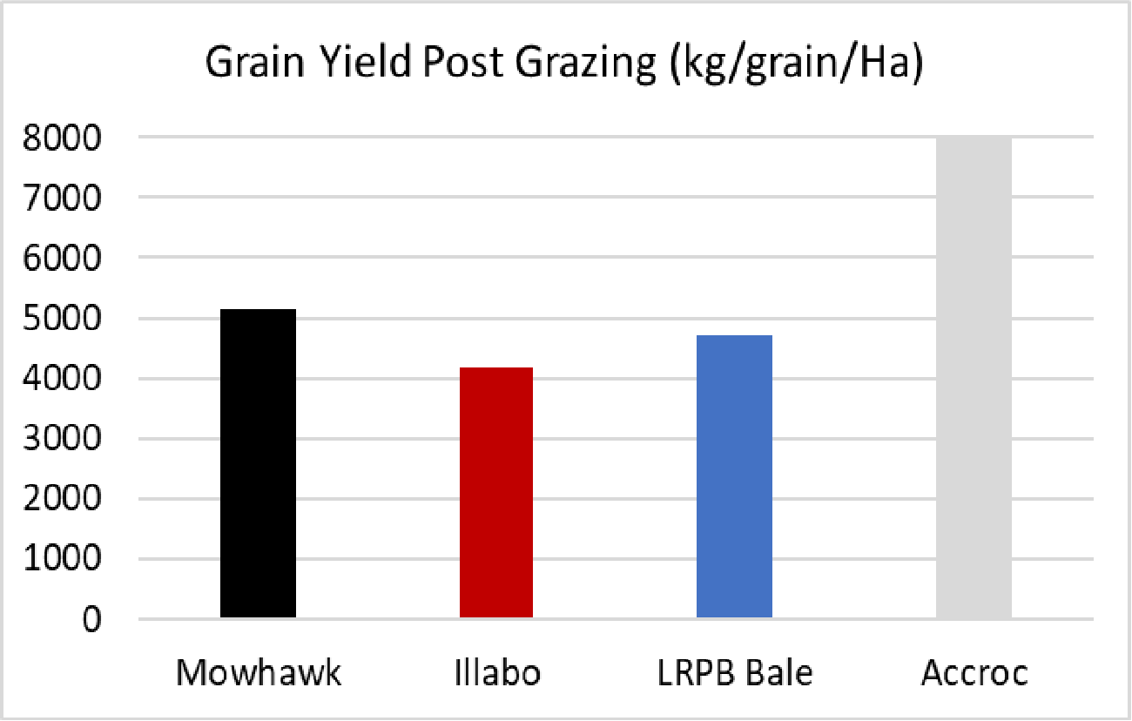
DIRPD WA TOS yield performance 2022
Harvested 30.6.22
Harvested 1.8.22
Harvested 20.8.22
These third party research trials were contacted by DIRPD WA in collaboration with Nutrien Ag Solutions, at the Manjimup research station in 2022.
This simulated grazing research trial was paid for by the Nutrien group to gain a better understanding of potential fit and benefit for their clients/growers.
Mowhawk out performed Illabo for dry matter harvested for grazing cuts 1 & 2.
Mowhawk recovered after grazing to yield just under 1 t/ha more than Illabo.
Mowhawk has the potential to be a reliable dual-purpose quick-winter wheat.

Slide 14
Disease profile
2022 NVT disease ratings comparison of Mowhawk | Denison | Illabo | Mowhawk | Rockstar
Disease | Cutlass | Denison | DS Pascal | Illabo | Longsword | Mowhawk | RockStar
Leaf Rust (Lr) | RMR | S | MS | S | MR# | MR (P) | S
Stem Rust (Sr) | R | MS | MSS | MRMS | MR | RMR (P) | MRMS
Striper Rust (Yr) WA | RMR | MR | RMR | RMR | RMR | RMR (P) | RMR
Yellow Leaf Spot (Yls) | MSS | MRMS | MS | MS | MRMS | MRMS (P) | MRMS
Powdery Mildew (Pm) | S | SVS | RMR | R | MRMS | *RMR (P) | MSS
P - Preliminary rating from first year testing; Rating as in 2022 disease report NVT online; *LRPB rating for Powdery Mildew based on two years of internal pathologist testing data
Mowhawk has an excellent overall disease package, with broad resistance to all 3 rusts as well as good resistance to Yellow Leaf Spot (MRMSp) and Powdery Mildew (RMRp)
Has a better Leaf rust rating than Denison, DS Pascal and Rockstar
Stem rust is better than most on the market
Yellow Leaf Spot is better than Illabop and DS Pascalp
Powdery Mildew is similar to that of DS Pascalp and Illabop but significantly better than Densionp and Rockstarp, as required in a longer season variety

Slide 15
Pre-harvest sprouting comparisons
Table 1: Averaged falling numbers (FN) data of seven Slow-spring and quick winter wheat varieties sown across four sowing dates (TOS) at Gibson, WA in 2022
Table 3: Falling number (FN) for sixteen wheat varieties sown at three sowing dates at Gibson in 2021
Variety | TOS1 - 27 April | TOS2 - 11 May | TOS3 - 24 May | TOS4 - 07 June
 | FN | FN | FN | FN
Cutlass | 275 | 355 | 342 | 270
Denison | 336 | 399 | 410 | 386
DS Pascal | 394 | 428 | 424 | 403
Mowhawk | 376 | 441 | 420 | 381
Illabo | 342 | 361 | 363 | 345
Valiant CL Plus | 209 | 293 | 279 | 190
Rockstar | 64 | 186 | 284 | 217
Variety | TOS1 - 21 April | TOS2 – 6 May | TOS3 - 21 May
 | FN | FN | FN
Cutlass | 345 | 358 | 350
Denison | 395 | 405 | 397
DS Pascal | 423 | 389 | 401
Mowhawk | 426 | 389 | 380
Illabo | 354 | 362 | 350
Valiant CL Plus |  |  | 251
Rockstar | 144 | 148 | 156
Table 2: Averaged Falling Number (FN) data of six Slow-spring and quick winter Wheat varieties sown across four sowing dates (TOS) at Mullewa, WA in 2022
Mohawk received a preliminary PHS tolerance FNI rating of 5p, which is the same as Illabo
The bench mark for PHS tolerance is DS Pascal (7)
Mohawk has a solid and dependable grain receivals package combined with good PHS tolerance, fitting for the longer season target environments
Variety | TOS1 - 8 April | TOS2 – 22 April | TOS3 - 6 May | TOS4 – 20 May
 | FN | FN | FN | FN
Cutlass | 410 | 360 | 415 | 406
Denison | 408 | 445 | 443 | 409
Mowhawk | 420 | 418 | 420 | 407
Illabo | 391 | 435 | 423 | 417
Valiant CL Plus | 404 | 416 | 431 | 421
Rockstar | 274 | 377 | 392 | 427
This FN data supplied to LongReach Plant breeders is from independent field trials designed to assess Preharvest sprouting risk of varieties commonly grown by WA growers which are conducted and managed by expert researchers of DIPRD WA. All FN values presented are the average of three field replicates per site. Important to note the threshold for downgrade of grain delivered is <300, indicated in red in the tables.

Slide 16
New Release 2023
LongReach Mowhawk is a NEW and exciting WA bred alternative to Illabo.
A high yielding well adapted AH “Quick Winter” wheat for WA available for 2023 planting.
For seed associates:
Bill Sharp, Multiseed Productions Email: multiseed@westnet.com.au Mob: 0428 711 375
Shane Starling, EDSCO (Eastern Districts Seed Cleaning Co)
Email: edsco@wn.com.au Ph: 08 9045 4539
Chris Martin, Australian Seed and Grain P/L
Email: sales@austseedgrain.com.au Ph: 08 9651 1079

